Slide 1
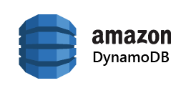
IST 769: Advanced Big Data Management
Research Project
-Karan Bharadwaj
-Thejaswini Ram

Slide 2
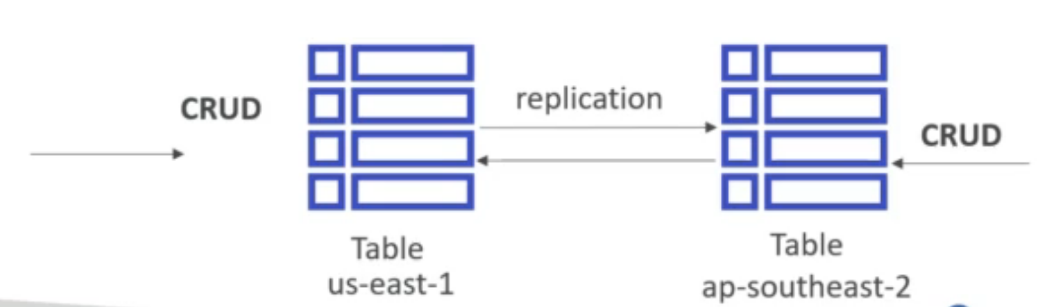
Key Features
Fully managed, highly available NoSQL key – value database with replication across 3 AZs.
It is a distributed serverless database, scales to massive workloads with single digit millisecond latency.
Provides for Global Tables, which is a multi region, multi master version of DynamoDB (cross region replication for low latency)
Recently started offering transactional support across multiple tables (ACID support)
Secondary indexes (GSI and LSI) can be used to provide an application access to different query patterns.

Slide 3
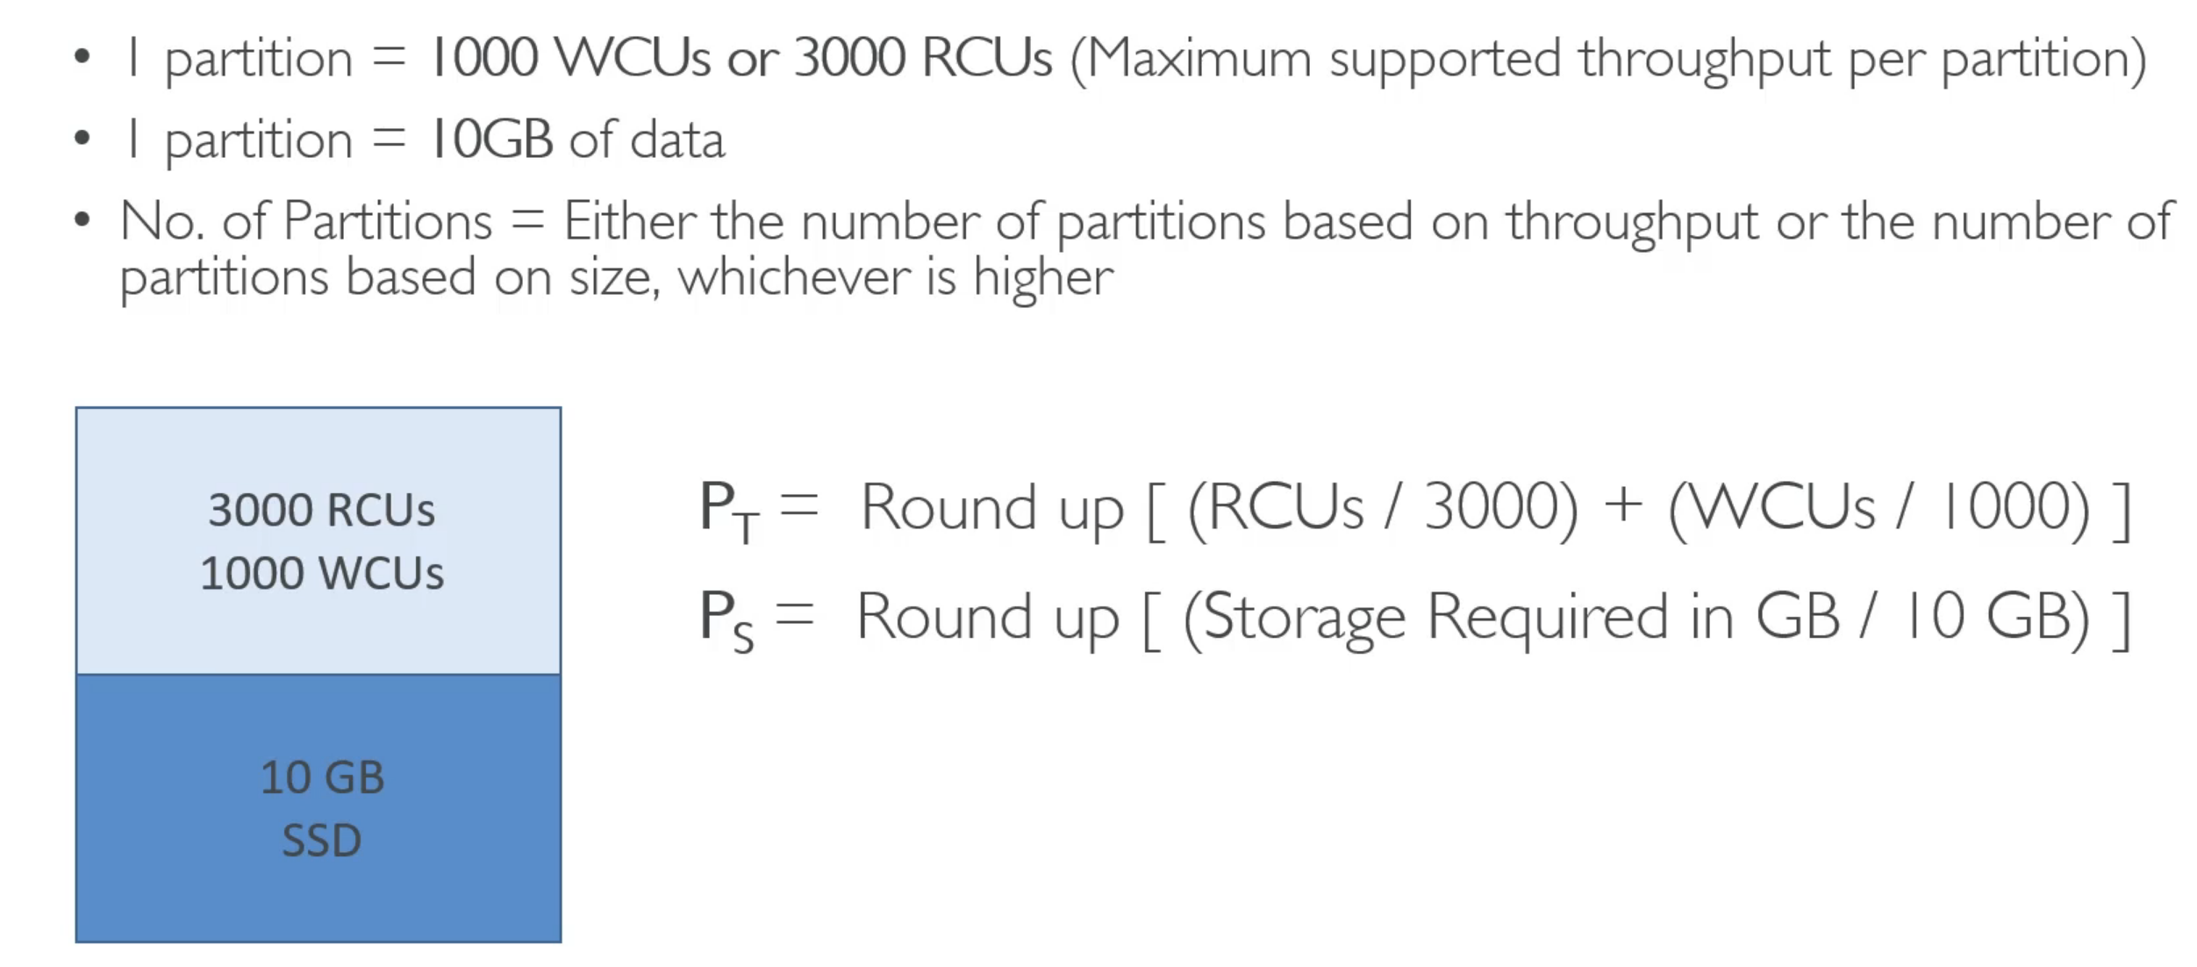
Storage
Each physical DynamoDB partition = 10 GB SSD volume
1 physical partition can have multiple logical partitions based on partition keys.
Number of partitions issued is managed internally by DynamoDB.
Auto scaling in DynamoDB can be employed by setting the desired target utilization, minimum and maximum provisioned capacity.

Slide 4
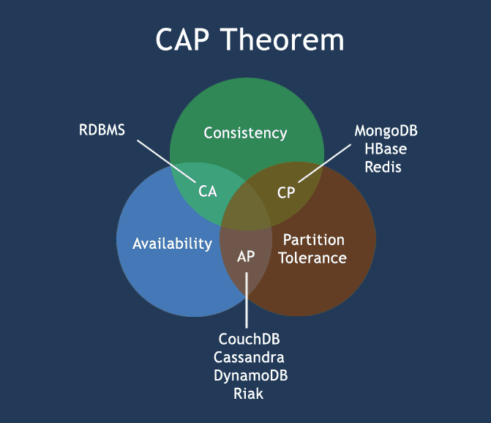
How does it fit within the CAP Theorem
DynamoDB is configured to choose availability and partition tolerance with eventual write consistency.
While DynamoDB supports eventually consistent and strongly consistent reads, the latter function can often fail during partitions and network delays. This type of inconsistency is not optimal for global applications.

Slide 5
Appropriate use cases
If there is a need for a fully managed database service.
Have had scalability problems with other traditional database systems.
Are working with an online transaction processing (OLTP) workload. High-performance reads and writes are easy to manage with DynamoDB, and you can expect performance that is effectively constant across widely varying loads.
Are deploying a mission-critical application that must be highly available at all times without manual intervention.
Require a high level of data durability, regardless of your backup-and-restore strategy.
To take advantage of seamless integration with the AWS ecosystem.

Slide 6
Innapropriate use cases/ Limitations
Some unsuitable workloads for DynamoDB include:
Services that require ad hoc query access. Though it’s possible to use relational frameworks to implement entity relationships across DynamoDB tables, these are generally cumbersome.
Online analytical processing (OLAP)/data warehouse implementations. These types of applications generally require distribution and the joining of fact and dimension tables that inherently provide a normalized (relational) view of your data.
Binary large object (BLOB) storage. DynamoDB can store binary items up to 400 KB, but DynamoDB is not generally suited to storing documents or images. A better architectural pattern for this implementation is to store pointers to Amazon S3 objects in a DynamoDB table.

Slide 7
Query langauge used
In Amazon DynamoDB, you can use either the DynamoDB API, or PartiQL, a SQL-compatible query language, to query an item from a table.
Amazon DynamoDB supports PartiQL, a SQL-compatible query language, to select, insert, update, and delete data in Amazon DynamoDB.
Using PartiQL, you can easily interact with DynamoDB tables and run queries using the AWS Management Console, NoSQL Workbench, AWS Command Line Interface, and DynamoDB APIs for PartiQL.

Slide 8
Competitors
Azure Cosmos DB
Google Cloud Firestore
Redis
Couchbase
MongoDB
ArangoDB

Slide 9


Slide 10


Slide 11


Slide 12

References:
https://www.udemy.com/share/1043Vs3@nscJZW49TiwH0e_YiCmzdt_4TNubD8i5b5HnnXd0SYGsze9W30NwkX4CpCiFp2RlMg==/
https://hevodata.com/learn/boto3-lambda/
https://db-engines.com/en/system/Amazon+DynamoDB%3BMicrosoft+Azure+Cosmos+DB
https://www.udemy.com/share/1044by3@8hBdmSvZThM5AJwW2uml3Ena_t-nnlheZihUwfqbVnJPQRngegFxzEAudR3EFGDLiA==/
https://docs.aws.amazon.com/amazondynamodb/latest/developerguide/getting-started-step-1.html

Slide 13
Thank You!

